Slide 1
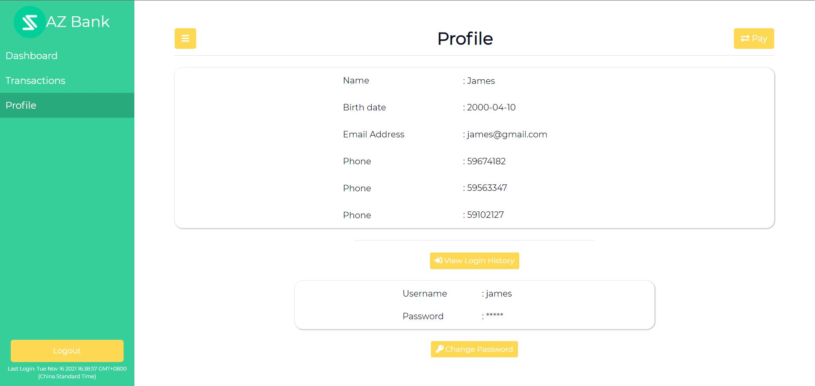
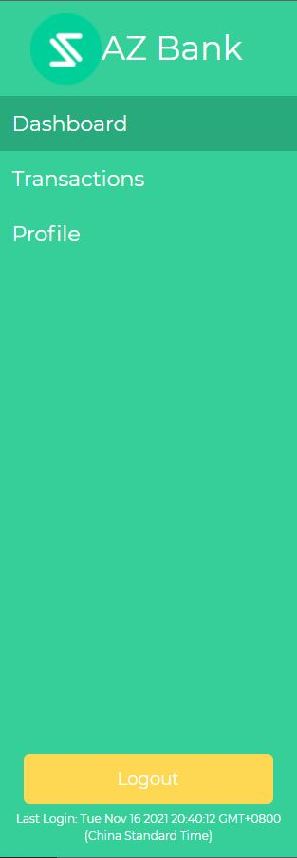

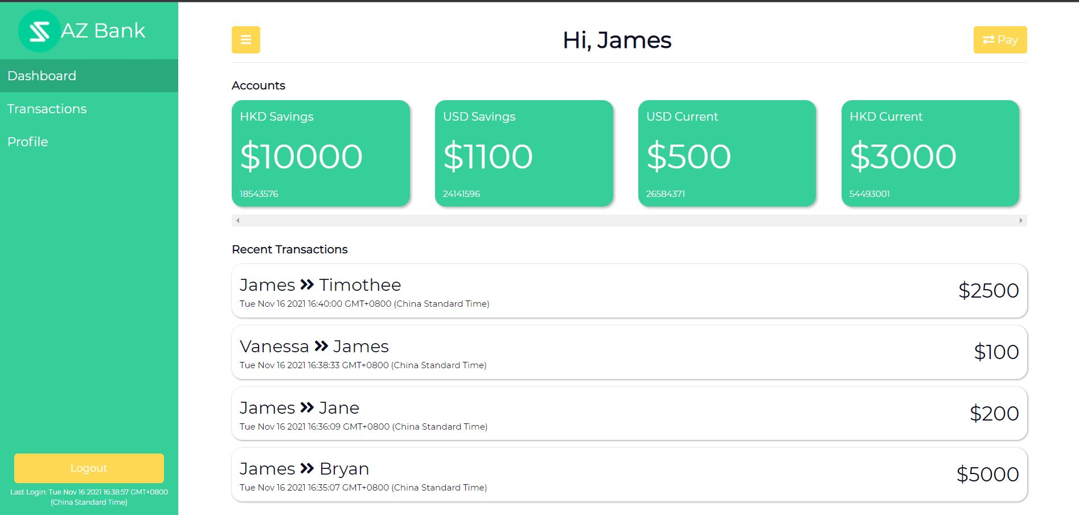
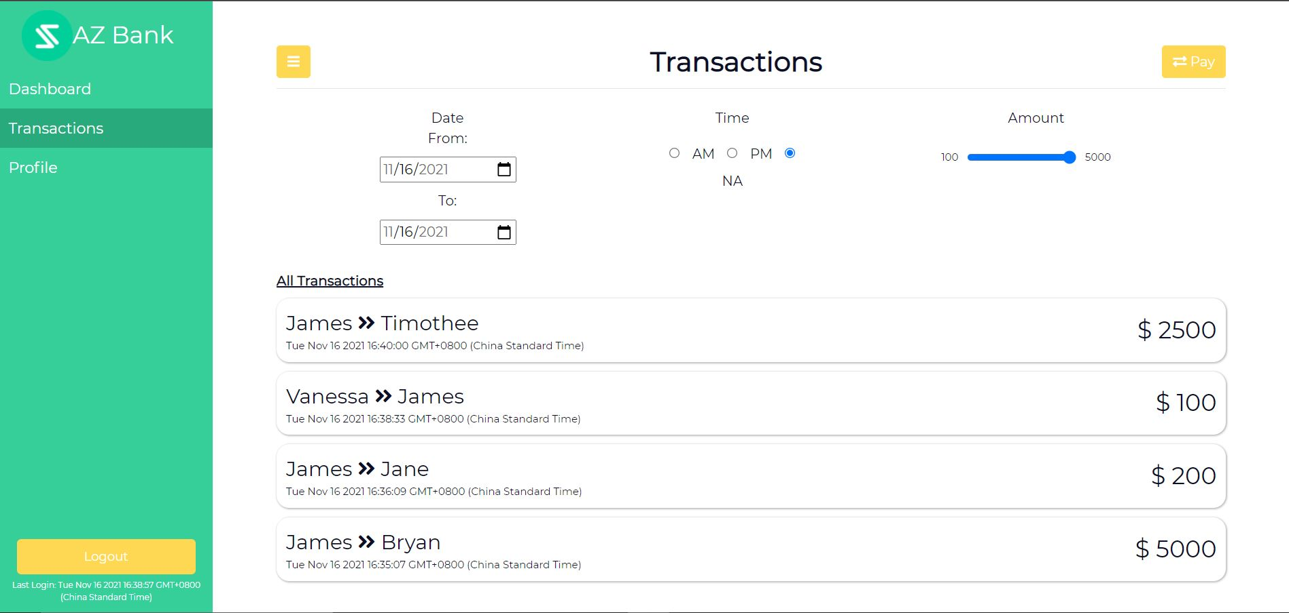
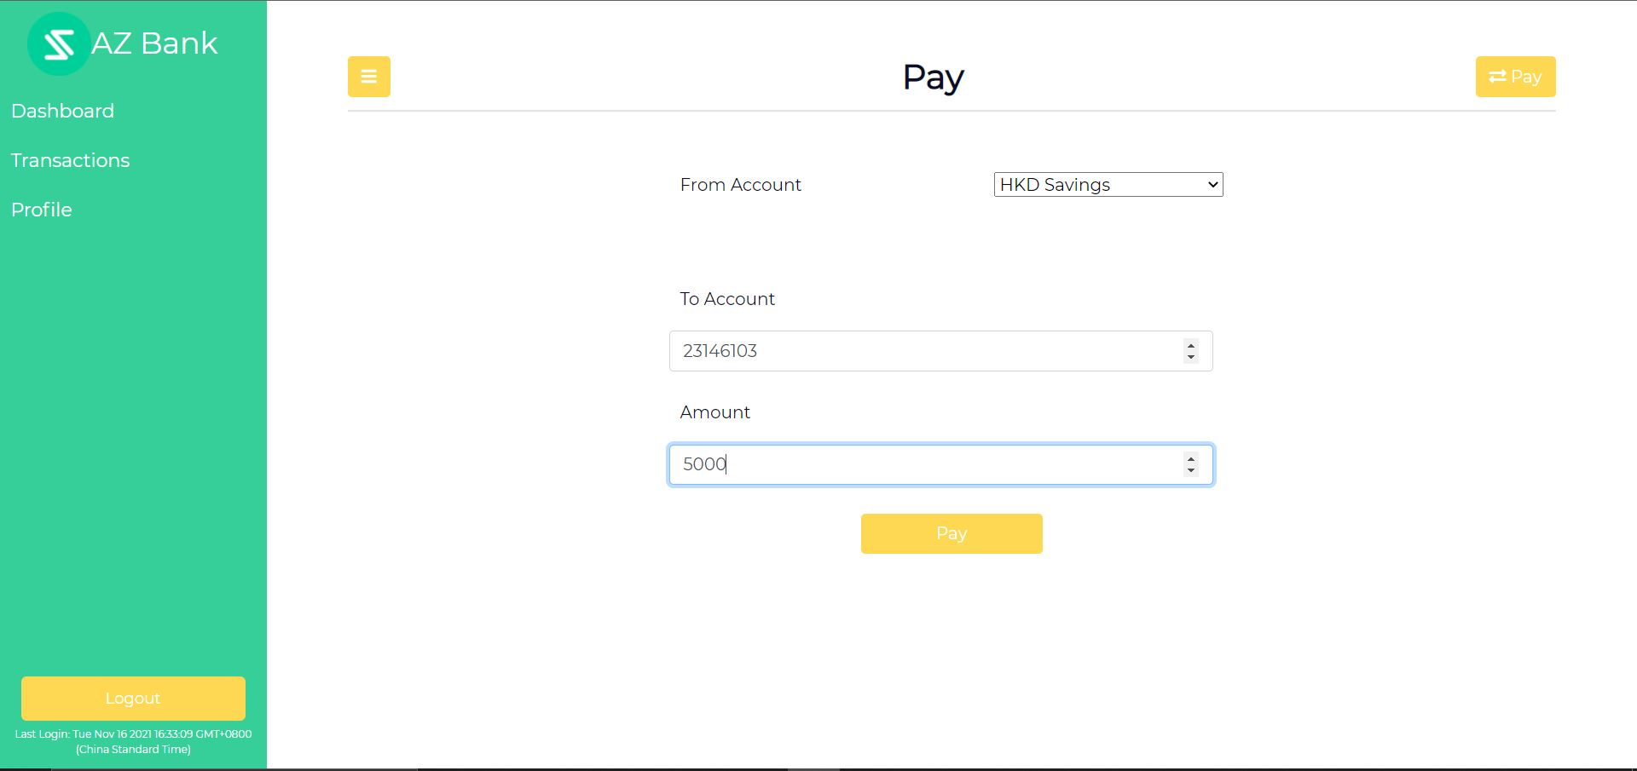
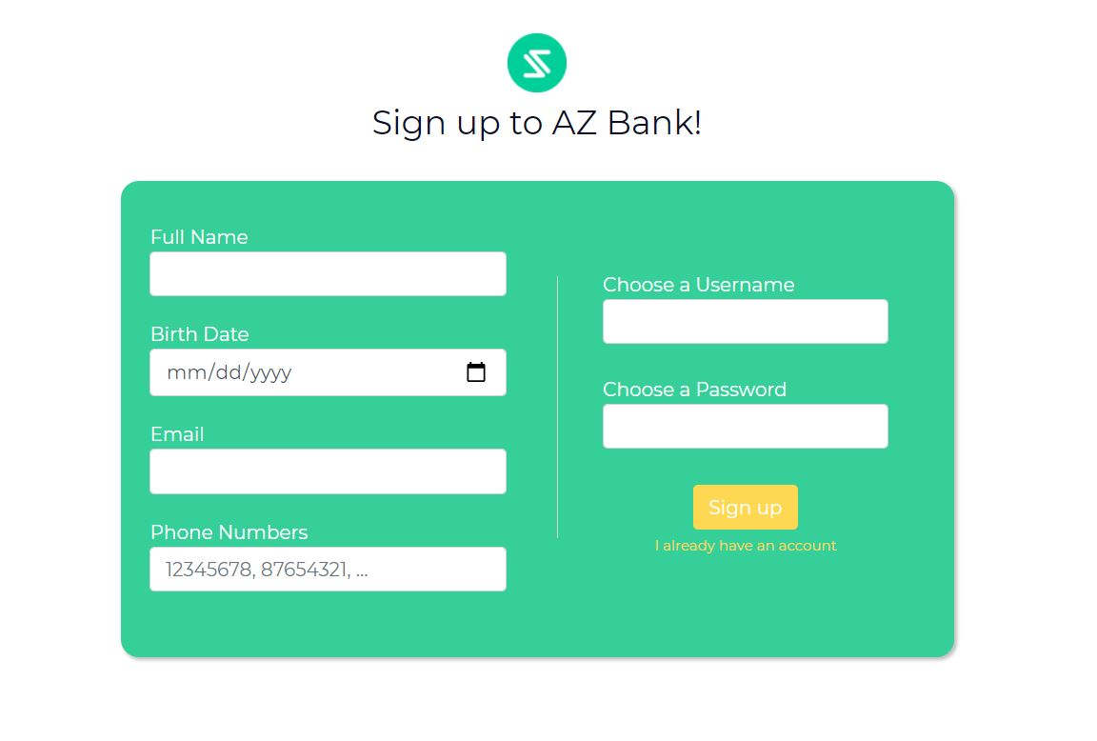
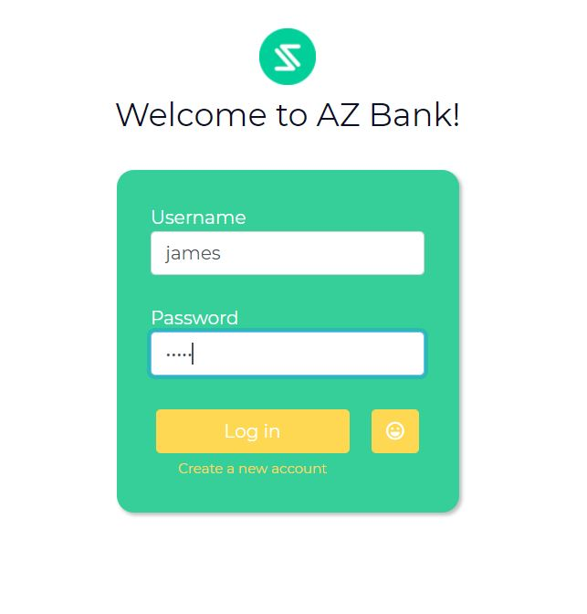

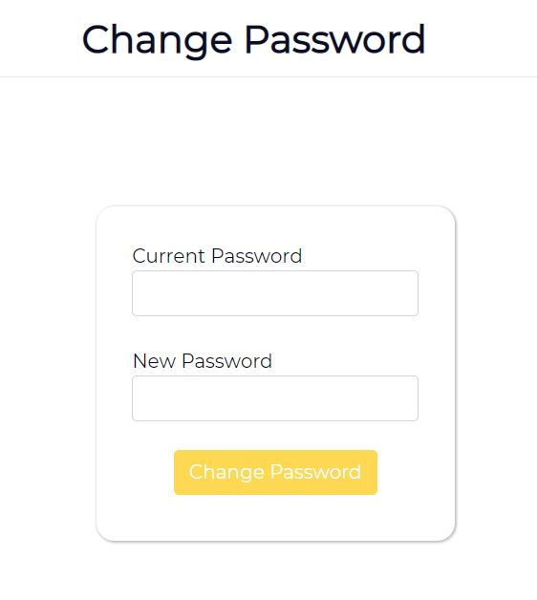
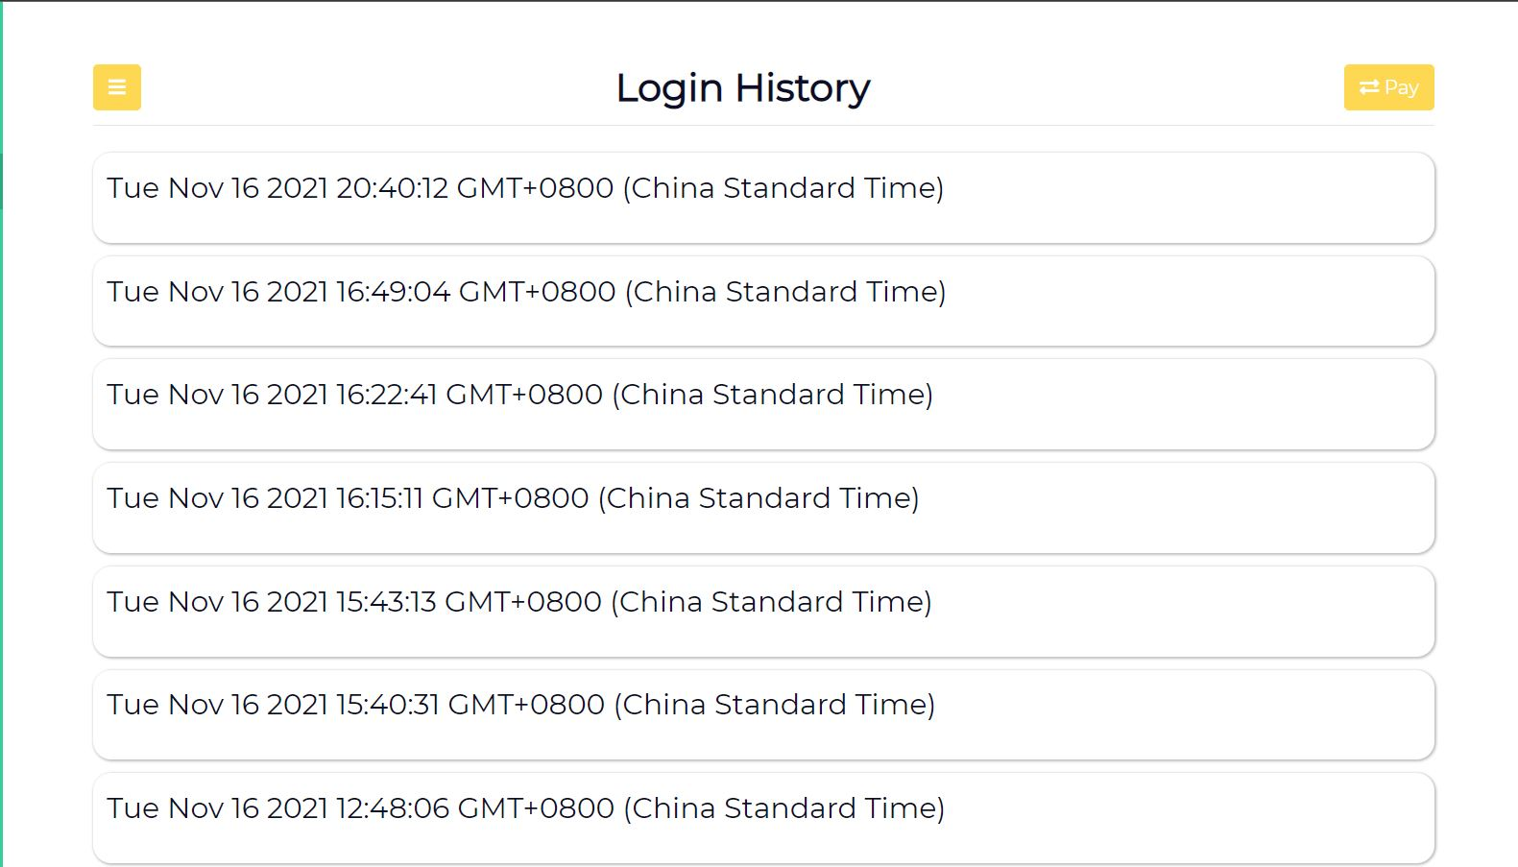
User Interface Implementation
Design and Features
Login & Registration Page Users would need to provide their personal details and go through facial recognition registration Users would be able to login by: 1. Entering their personal details 2. Facial Recognition
User Dashboard Our dashboard displays: 1. Customized welcome message 2. All the user’s accounts
3. Recent transactions involving the current user
Profile Page The profile page displays:
All the customer’s details such as name, birthdate, etc.
The customer’s login details (username, password)
Other features:
View login history
Change password
Payment Page The payment page enables users to make payments with the constraints:
Balance is sufficient
Transaction to an account with the same currency
Transactions Page Our transactions page displays:
By default display all the transactions involving the current customer
Display transactions based on filters applied (date, time, and/or amount)
Menu Sidebar Every main page of the web application has a sidebar, which can:
Redirect to other pages
Logout from customer’s account
Display last login of the customer
Redirect to the payment page to create transactions
AZ Bank

Slide 2
time
Database Implementation and Design
account_type
to
from_account
customer_id
Transaction
Customer
Customer Login
History
Transaction
from
Account
transaction_id
account_num
amount
to_account
currency
Account
customer_id
customer_id
time
has
username
balance
username
phone_number
account_type
from_account
phone_number
customer_id
birthdate
Transaction
customer_id
transaction_id
username
CustomerLoginHistory
customer_id
birthdate
username
Account
name
to_account
amount
Customer
login_history
currency
Customer
password
CustomerLoginHistory
name
login_history
account_num
last_login
email
password
email
login_history
balance
last_login
Entities
Final Entities with Relations

Slide 3






Contributions
Milestones
Problems Faced
October 15
November 1
November 10
Querying for users’ names who are involved in transactions with the currently logged-in user (require querying from Customer, Account, Transaction table)
Integrating the facial recognition feature which written in Python with Node.JS.
Version Control
Database and User Interface Design Planning
Front-end development
Bug fixes and code optimization
Solution
We stored the resulting table acquired from the previous process as a temporary table, and combine join them with 2 account tables and 2 customer tables to obtain the sender’s and the recipient’s names.
Solution
We imported a built-in module in node called child_process that is able to run subprocesses from the system shell. Specifically, we used the spawn() function to run the Python scripts that are provided by the TA.
Solution
We educate ourselves on how to use version control and GitHub effectively, such as git stash before pulling a commit and popping our changes afterwards to avoid merge conflicts.
Back-end development integrated with MySQL
Python & Node.js integration for facial recognition feature
Slides and Video Preparation
October 25
November 8
November 16

